Slide 1
Scholarly Publishing in China: Overview and Opportunities
Dr. Lifang Xu
Publishing Science Department, School of Information Management, Wuhan University, China

Slide 2
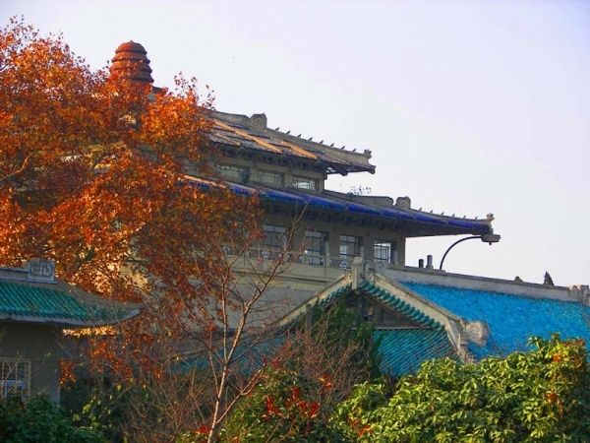
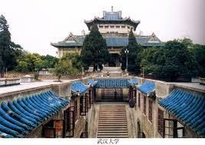
Notes:
Wuhan University (WHU) is a comprehensive and key national university directly under the administration of the Ministry of Education. It is also one of the "211 Project" and "985 Project"universities with full support in the construction and development from the central and local government of China.
The history of Wuhan University can be traced back to Ziqiang Institute, which was founded in 1893 by Zhang Zhidong, the then governor of Hubei Province and Hunan Province in the late Qing Dynasty. In the process of development and evolution, the institute changed its name several times before it was finally named Wuhan National University in 1928. It is one of the earliest comprehensive national universities in modern China. By the end of 1946, the university had established 6 colleges, the colleges of liberal art, law, sciences, engineering, agriculture and medicine. In 2000, an amalgamation of the former Wuhan University, Wuhan University of Hydraulic and Electric Engineering, Wuhan Technical University of Surveying and Mapping, and Hubei Medical University was announced, which ushered in a new era in its 100-odd years of development.
For the past century, Wuhan University has built an elegant palatial architectural complex of primitive simplicity which blends perfectly the eastern architectural style with that of the west. It is honored as the "Most Beautiful University in China." Furthermore, Wuhan University's centennial humanistic accumulation boils down to its succinct motto, that is, "Improve Oneself, Promote Perseverance, Seek Truth and Make Innovations."
Since its establishment, Wuhan University has cultivated more than 300 thousand professional talents in various occupations, among whom there are over 100 members of the Chinese Academy of Science and the Chinese Academy of Engineering. They have made great contribution to the national construction and social advancement. The remarkable achievements of Wuhan University have won itself an extensive international reputation. In 1999, the world renowned journal Science listed Wuhan University as one of the most prominent institutions of higher education in China.
Burgeoning are the international exchanges and cooperation of Wuhan University in recent years. It has established cooperative relationship with more than 300 universities and research institutes in over 40 countries and regions.
Now Wuhan University is endeavoring to shape itself into a world-class comprehensive research university domestically and internationally. Students Full-time undergraduate students 32,640 Full-time master degree candidates 13,170 Ph.D candidates 7,191 International students 1433
Programs Undergraduate programs 114 Master's degree programs 311 (including 20 master's programs for professional degrees) Ph.D programs 208 (including 2 doctoral programs for professional degrees) Centers for postdoctoral studies 32
Faculty and Staff Members of full-time faculty 3,639 Professors 1,139 Associate professors 1,258 Academicians from the Chinese Academy of Sciences 4 Academicians from Chinese Academy of Engineering 7 Staff 4,362
Other State key disciplines 5 State key sub-disciplines 17 State key laboratories 4 National bilingual teaching demonstration courses 5 National engineering research centers 2 Key laboratories at the level of the Ministry of Education12 Engineering research centers at the level of the Ministry of Education 5 Key bases for humanities and social sciences research at the level of the Ministry of Education 7 National bases for basic scientific research and talents cultivation 10 National experimental teaching demonstration centers 8 National base for cultural-quality-oriented education of university students 1 Key research bases at provincial and ministry level 36

Slide 3
Mary Elizabeth Wood (August 22, 1861 – May 1, 1931) was an American librarian and missionary, best known for her work in promoting Western librarianship practices and programs in China. She is credited with the foundation of the first library school in China, the Boone Library School, as well as spurring the development of Chinese librarianship as a modern profession.
Publishing Science Department
Boone Library School
(1929)
Library Science Program
(1920)

Slide 4
R&D as a Background

Slide 5
Sources of Funding for Research in China
National Level ↓
National Social Sciences Fund, since 1991, 21 areas
National Natural Science Fund, since1982,7 fields
There are two kinds of funds in this foundation, one for projects and the other for talents
National Key Technology R&D Program
National High-Tech R&D Program of China (863 Program)
1986~2005, ￥30 Billion
National Key Basic Research Program (NKBRP, 973 Program)
Torch Program

Slide 6
Ministerial Level ↓
Project of Chinese Ministry of Education
Project of Ministry of Agriculture
Project of Ministry of Health
……
Local Level ↓
Provincial projects
Municipal projects
University projects
……
Horizontal projects →
Enterprise projects
International coordination projects
……

Slide 7
Fig. 1 R&D Funding Sources in China （%）

Slide 8
Notes:
2011年我国R&D经费规模超过8687亿元，按2011年平均汇率折算为1344亿美元（1美元兑6.461元）。R&D经费规模继续保持高速增长，2008—2011年平均增长速度达到29.1%（可比价），是全球增长速度最快的国家。
与此同时，受国际金融危机和欧洲主权债务危机的影响，发达国家放慢甚至减少了对国内R&D活动的经费投入。按可比价计算，2008年前3年，美国和英国R&D经费年增长率曾经高达10%以上。但2008—2011年期间美国R&D经费年均增长速度只有2.1%，英国约3.9%，法国、德国R&D经费年均增长速度分别为4.1%和4.5%；2010年与2008年相比，日本R&D经费下降约12%。

Slide 9
Fig 3. Six Countries’ R&D Expenditure (million dollars)
Source: China Main Science and Technology Indicator Database(OECD data). http://www.sts.org.cn/tjbg/zhqk/documents/2012/201303282.htm

Slide 10
Fig. 4 Eleven Countries’ R&D Expenditure (% of GDP)
Source: China Main Science and Technology Indicator Database. http://www.sts.org.cn/kjnew/maintitle/Rdnc.asp?Mainq=1&Subq=5&Sele=(1,2,3,4,5,6,7,8,9,10,11,12,13,14,)&

Slide 11
Five Chinese Researchers
One American
Researcher
Source: Yasheng, Huang. What led to a low efficiency for Chinese research[J]. Entreprenur, 2009(11): 138
Low efficiency!
Source: Huping, Shang, et al. Public Finance Efficiency of Chinese Scientific Research[J]. Studies in Science of Science, 2009(11): 1475， 1476-1487
NSFC
DIISR
SSFC
￥20994/paper
￥5472/paper
￥14248/paper
3.8 times
2.6 times
Notes:
，我国创造一个
单位GDP 需要的研发人员是美国的4． 48 倍，我国4－ 5 个科研人员才抵得上美国的一名科研人员。
Department of Innovation Industry Science and Research (Australia).
，我们只以澳大利亚国立大学
完成该国创新、工业与科研部( DIISR) 的科研基金
的产出作为标杆。严格来说这仅仅是澳大利亚的
“部级”课题，但即使这样，该课题产出1 篇论文平
均只需花费5472 元人民币的公共资金，而国内社科
项目每平均篇论文需花费14248． 41 元财政经费，是
澳大利亚的260． 4%，自然科学基金项目平均每篇
论文平需花费20993． 88 元的公共财政经费，是澳大
利亚的383． 7%。

Slide 12
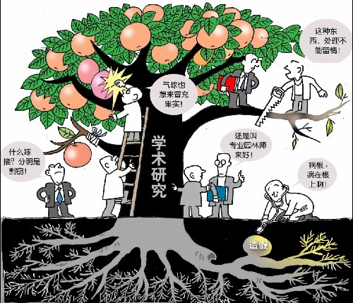
Research Outputs as a Background

Slide 13
According to the statistics from ISTIC (Institute of Scientific and Technical Information of China)
Chinese institutions as the first authors’ affiliations:
In 2011, 143 600 internationally published papers; 29.8%, citations above subject areas’ average citations, increased 10.1% over 2010.
In 2011, 530 000 domestically published papers; 29.8%, citations above subject areas’ average citations, increased 10.1% over 2010.
134 journals was indexed by SCI, increase 6 titles over the earlier year; 211 journals was indexed by EI; 102 BY Medline; 738 in Scopus.
2002~2011, 1 022 600 internationally published papers, ranked No. 2; cited 6 653 400 times, ranked No.6, 6.51/paper, grow 4.8% over the previous year.
2002~2011, the average impact factor of domestic journals is 0.454, CAGA (Compound annual growth rate) is 13.9%
Notes:
doi:10.3969/j.issn.2095-1329.2012.04.027
中国科技信息研究所发布2011年度中国科技论文统计分析报告
2012年12月7日，中国科学技术信息研究所发布中国科技论文统计与分析年度研究报告。2011年，我国
国内机构为第一署名单位的国际论文共14.36万篇，其中被引用次数高于学科均线的论文占29.8%，较2010
年上升10.1个百分点；2002年至2012年（截至2012年11月1日）我国科技人员共发表国际论文102.26万篇，
居世界第2位；论文共被引用665.34万次，排在世界第6位，平均每篇论文被引6.51次，比上年提高4.8%。我
国有14个学科论文被引用次数进入世界前10位，比上年增加2个学科，其中化学、材料科学、工程技术、数
学等4个领域论文的被引用次数排名世界第2位，计算机科学、物理学和地学等进入世界前5位。
2011年我国作者在国内1998种中国科技期刊上共发表论文53万篇；科技期刊的影响因子平均值为
0.454，十年年均增长率5.6%；期刊的总被引频次均值为1022次，十年年均增长率为13.9%。2011年，SCI数
据库收录中国科技期刊134种，较上年增加6种；EI数据库收录211种，Medline数据库收录102种，Scopus数
据库收录738种。
《上海国土资源》2011年度的相关统计分析指标为：影响因子0.918，总引用频次422，即年指标0.679，
他引率0.40，引用刊数118，学科影响指标1.15，学科扩散指标1.82，被引半衰期5.14，h指数4，在“万方数
据”的年度下载量为4868篇次。而2010年度本刊的相关指标为：影响因子0.553，总引用频次291，即年指标
0.188，他引率0.73，引用刊数132，学科影响指标0.18，学科扩散指标1.83，被引半衰期5.69。
本刊编辑部

Slide 14
Chinese Scholarly Publishing Overview: some features
Chinese STM journal publishers are usually very small. There are no such thing like “800-pound gorilla” in the arena.
10,000 titles of books/ year
300 STM Journals

Slide 15
Chinese publishing houses paid more attention to books/monographs.
Societies/ associations, universities/ colleges, government agencies, non-for-profit, esp. before 2012
From the economic perspective, Chinese STM Journal publishing is insignificant.
Another three features

Slide 16
Very low STM journal prices in China
Few publishers could control the market and raise the subscription fees.
Fostered “ Big 3” digital STM journal aggregators since mid-1990s in China
CNKI.com(National Knowledge Infrastructure), 8000 titles, (1915-)
Wanfangdata.com, >7000 titles (1998- )
cqvip.com, 12000 titles

Slide 17
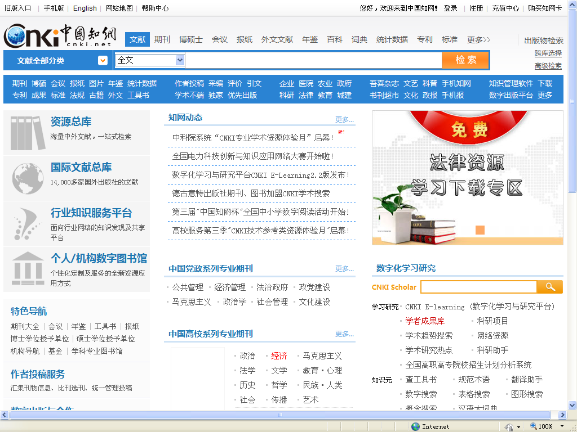

Slide 18
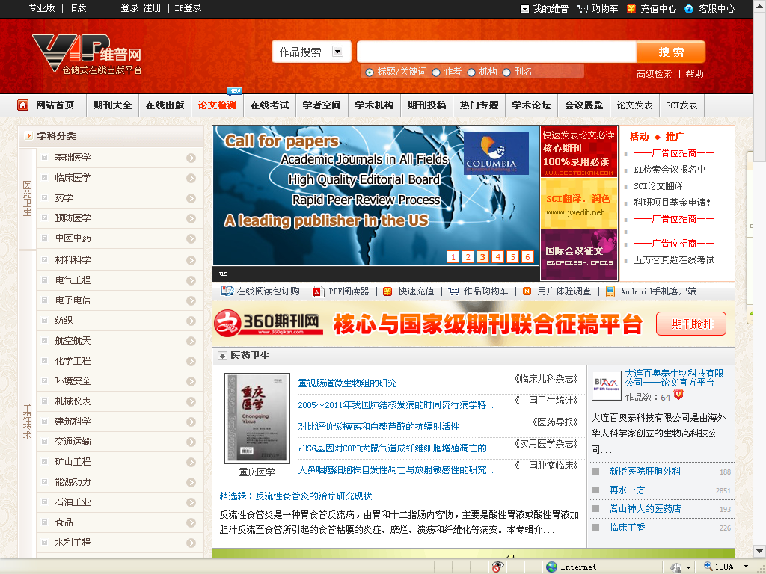

Slide 20
‘three-level Review’ instead of “peer review”
1 2 3
Head of editorial department
Editors
Editor-in-chief
Peer experts
Copy editing
Fig. 1 The ‘three-level Review’ System for Academic Journals in China
Source: Fang Qing, Xu Lifang, Lian Xiaochuan. Peer-Review Practice and Research of Academic Journals in China. Journal of Scholarly Publishing, 2008, Vol.39 No. 4: 417-427.
Notes:
The ‘three-level review’ is based on the hierarchy of Chinese publishing houses: the first review is done by the editor, the second review by the head of the editorial department, and the final review is finished by the editor-in-chief of the house.

Slide 21
Trends of Chinese Scholarly Publishing
Market– oriented Reform
Charging Article Publishing Fees
Raising Prices of Academic Books
Depending on Academic Publishing Funds
Internalization
Internationalization of Editors and Editorial Boards
Establish Publishing Workflows Centered around Peer-review
Internationalizing Journals’ Content and Form

Slide 22
Thank You!
谢 谢！

